Slide 1
Test Driven Development
“TDD”
A process focusing on reliability, progress, and confidence
Henrik Bærbak Christensen

Slide 2
Test-Driven Development
  To ensure that our software is reliable all the time
    “Clean code that works”
  To ensure fast development progress
  To ensure that we dare restructure our software and its architecture
    “Clean code that works”
Clean code that works
Henrik Bærbak Christensen
Henrik Bærbak Christensen

Slide 3
The Values
Keep focus
  Make one thing only, at a time!
  Often
    Fixing this, requires fixing that, hey this could be smarter, fixing it, ohh – I could move that to a library, hum hum, …
Take small steps
  Taking small steps allow you to backtrack easily when the ground becomes slippery
  Often
    I can do it by introducing these two classes, hum hum, no no, I need a third, wait…
Henrik Bærbak Christensen
Henrik Bærbak Christensen

Slide 4
The Values
Speed
  You are what you do! Deliver every 14 days!!!
  Often
    After two years, half the system is delivered, but works quite in another way than the user anticipate/wants…
  Speed, not by being sloppy but by making less functionality of superior quality!
Simplicity
  Maximize the amount of work not done!
  Often
    I can make a wonderful recursive solution parameterized for situations X, Y and Z (that will never ever occur in practice)
Henrik Bærbak Christensen
Henrik Bærbak Christensen

Slide 5
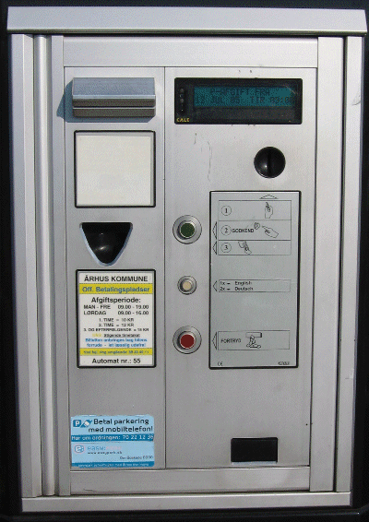
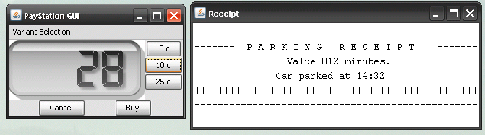
You are all employed today
Welcome to PayStation Ltd.
We will develop the main software to run pay stations.
[Demo]
Henrik Bærbak Christensen

Slide 6
Case: Pay Station
Welcome to PayStation Ltd.
Customer: AlphaTown
Requirements
  accept coins for payment
    5, 10, 25 cents
  show time bought on display
  print parking time receipts
  US: 2 minutes cost 5 cent
  handle buy and cancel
Henrik Bærbak Christensen

Slide 7
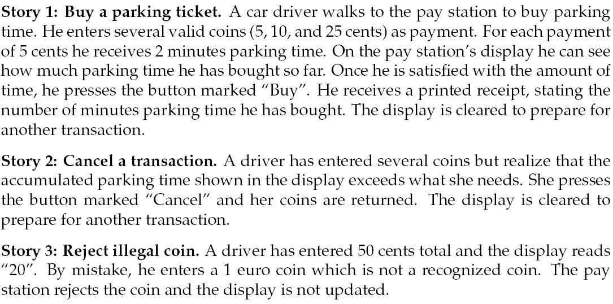
Stories
Henrik Bærbak Christensen

Slide 8
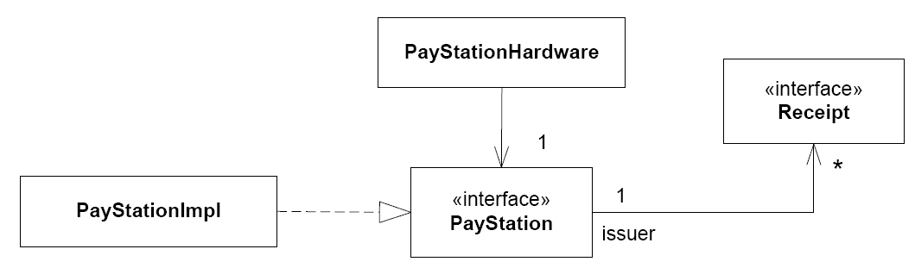
Design: Static View
For our purpose the design is given…
  Central interface PayStation
Henrik Bærbak Christensen

Slide 9
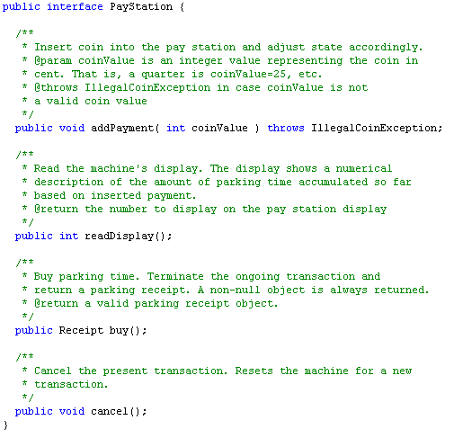
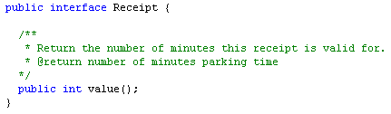
Design: Code View
Henrik Bærbak Christensen

Slide 10
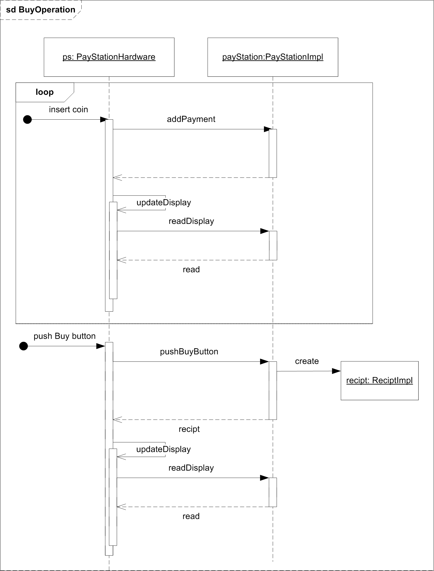
Design: Dynamic View
The envisioned
dynamics…
Henrik Bærbak Christensen

Slide 11
Minimum Terminology
[FRS chapter 2]
  Production code: source code that compiles to machine executable code that will provide behavior fulfilling the requirements of the user/customer.
  Testing code: source code that defines test cases for the production code.
  Failure: the damn thing does something wrong
  Defect: algorithmic cause of a failure
  Test case: definition of input values for a unit under test and the expected output
    Input: -37; UUT: Math.abs(x); expected output: +37
Henrik Bærbak Christensen

Slide 12
TDD
Structuring the Programming Process

Slide 13
How do I program?
Before TDD I had programmed for ~25 years...
But – I just did it...
I could not really express what I did!
A teaching assistant once told our students that he himself used divine inspiration when programming. A great help to beginners!
Henrik Bærbak Christensen

Slide 14
Structuring the Process
TDD replace tacit knowledge with a formulated process
  The rhythm
    The five steps in each highly focussed and fast-paced iteration.
  Testing principles
    The testing principles that defines a term for a specific action to make in each step
    Form: Name - Problem – Solution
Henrik Bærbak Christensen
Henrik Bærbak Christensen

Slide 15
The Fundamental TDD Principles
The Three Cornerstones in TDD

Slide 16

Principle: Test
Locke, Berkeley & Hume:
Anything that can’t be measured
does not exist.
Kent Beck:
Software features that can’t be demonstrated by automated tests simply don’t exist.
Henrik Bærbak Christensen
Henrik Bærbak Christensen

Slide 17
Test
Test
  Tests are often by developers considered something that other stakeholders are interested in...
  Testing is boring...
  But automated tests are something that we should write for our own sake...
    to have confidence in our code
    to dare change code radically
    to know when we are done
  You will get a chance to judge for yourselves...
Henrik Bærbak Christensen
Henrik Bærbak Christensen

Slide 18
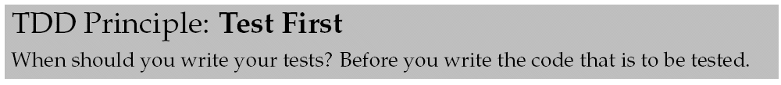
Principle: Test First
Because you won’t test after!
  Time has validated this observation ☺
Henrik Bærbak Christensen
Henrik Bærbak Christensen

Slide 19
My own experience
Developing module X
  write driver code “test program” for X
  edit-compile-debug...
Integrate X
  change X’s API here and there
Bang! Why does X not work???
  I did have a test program didn’t I?
  If I find it, it would take ages to make it run again
    and is the bug in X or in the rewritten test program?
Henrik Bærbak Christensen
Henrik Bærbak Christensen

Slide 20
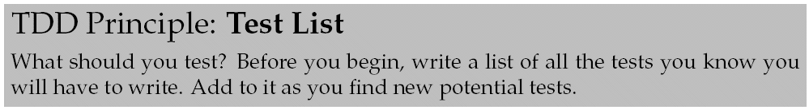
TDD principle
  “Never take a step forward unless you know where your foot is going to land”. What is it we want to achieve in this iteration ???
  Another strategy: Keep it all in your head.
    if you are a genius
    if your problem is a “Mickey Mouse” problem
Henrik Bærbak Christensen
Henrik Bærbak Christensen

Slide 21
The Rhythm

Slide 22
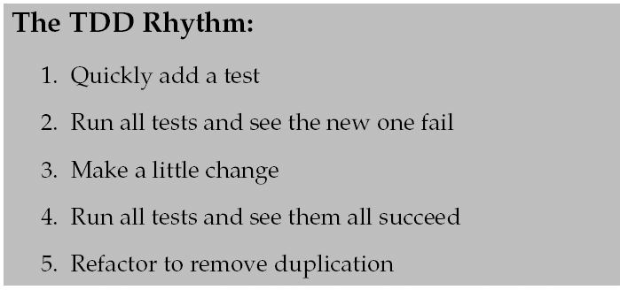
The Iteration Skeleton
Each TDD iteration follows the Rhythm
(6. All tests pass again after refactoring!)
Henrik Bærbak Christensen
Henrik Bærbak Christensen

Slide 23



The Rhythm: Red-Green-Refactor
The Rhythm
Clean part
Improve code quality
Implement delta-feature that does not break any existing code
Works part
Introduce test of delta-feature

Slide 24
Size of an iteration
An iteration is small typically adding a very very small increment of behavior to the system
Iterations (=all 5 steps) typically last from 1 to 15 minutes. If it becomes bigger it is usually a sign that you do not take small steps and have lost focus!
Henrik Bærbak Christensen

Slide 25
Pay Station by TDD

Slide 26
Back to the Pay Station
Let’s combine these first principles
  Test, Test First, Test List
Our starting point is the interfaces that define the domain model / business logic.
  User interface logic we can add later...
  that is: PayStation and Receipt
Henrik Bærbak Christensen
Henrik Bærbak Christensen

Slide 27
Exercise: Test List
Generate the Test List for these stories
Henrik Bærbak Christensen
Henrik Bærbak Christensen

Slide 28
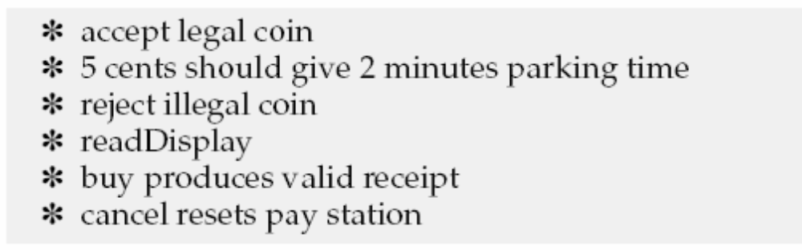
My answer
Henrik Bærbak Christensen

Slide 29
Iteration 0: Setting Up

Slide 30
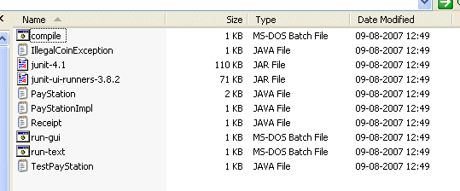
Demo
Henrik Bærbak Christensen
Henrik Bærbak Christensen

Slide 31
Compile and Execution
Supplied code has a ‘compile.bat’ script
  compile.sh for linux
It will compile the java code (surprise!)
Next, run the script ‘run-test.bat’
  Verbose output ☹
Or you do the magic in your favorite IDE ☺
  Eclipse has very nice support for JUnit
Henrik Bærbak Christensen
Henrik Bærbak Christensen

Slide 32
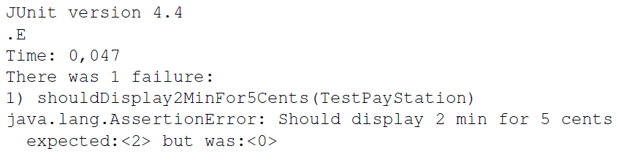
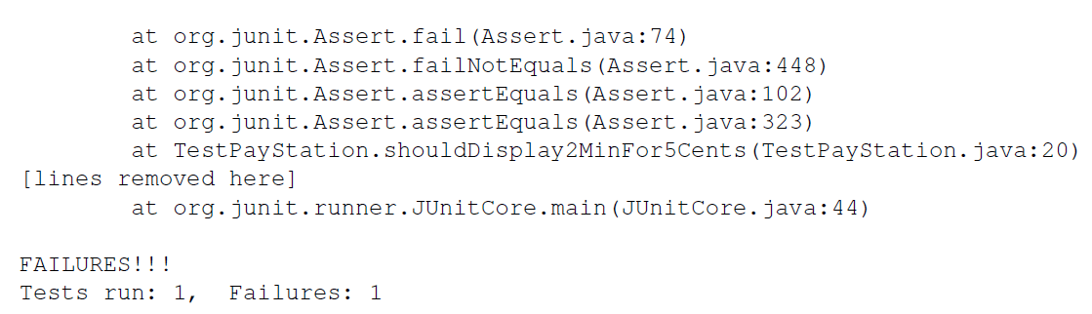
JUnit 4.x Raw (no GUI ☹)
Henrik Bærbak Christensen
Henrik Bærbak Christensen

Slide 33
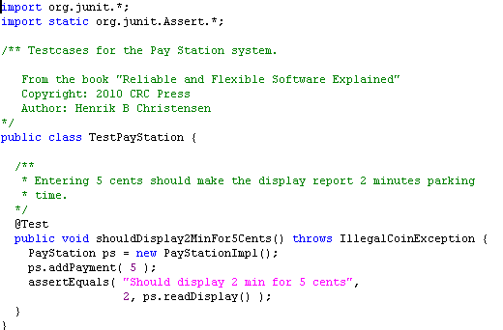
Testing Code
Henrik Bærbak Christensen
Henrik Bærbak Christensen

Slide 34
JUnit version
expected value
computed value
Henrik Bærbak Christensen
Henrik Bærbak Christensen

Slide 35
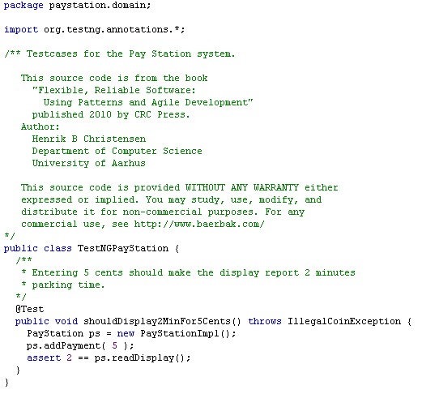
(TestNG version)
expected value
computed value
Henrik Bærbak Christensen

Slide 36
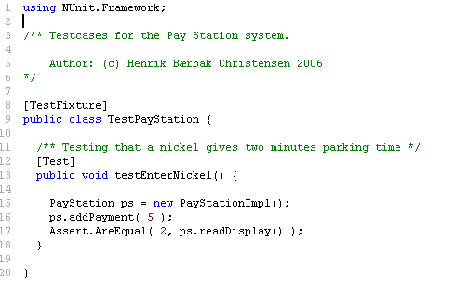
(NUnit Version)
expected value
computed value
Henrik Bærbak Christensen
Henrik Bærbak Christensen

Slide 37
Iteration 1: 5 ¢ = 2 min Parking

Slide 38
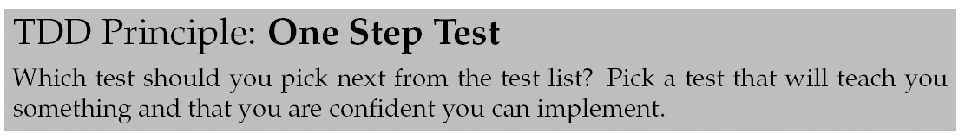
Which one to pick
OK, I have the initial test list and I have the rhythm…
Where do I start???
Henrik Bærbak Christensen

Slide 39
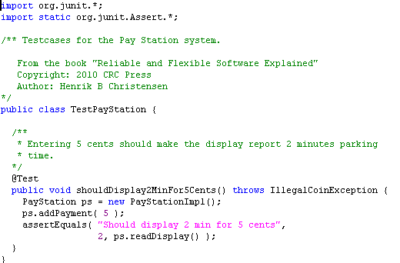
Step 1
Step 1: Quickly add a test
  The test case
    ps.addPayment(5);
    ps.readDisplay() == 2;
In JUnit
Henrik Bærbak Christensen
Henrik Bærbak Christensen

Slide 40
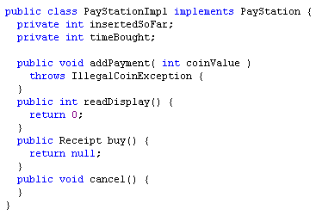
Step 2
Step 2: Run all tests and see the new one fail
  Require that I implement a PayStationImpl Temporary Test Stub
    All methods are empty or return null
Henrik Bærbak Christensen
Henrik Bærbak Christensen

Slide 41

Step 2
Henrik Bærbak Christensen
Henrik Bærbak Christensen

Slide 42
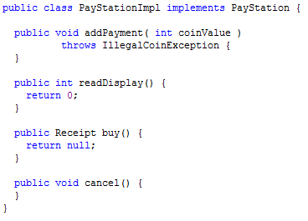
Step 3
3. Make a little change
Exercise: What should I do?
Remember:
  Keep focus!!!
  Take small steps!!!
Henrik Bærbak Christensen
Henrik Bærbak Christensen

Slide 43
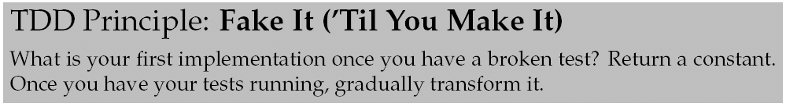
Step 3
This principle was very controversial to me!
Implement a solution that is known to be wrong and that must be deleted in two seconds???
Why???
Henrik Bærbak Christensen
Henrik Bærbak Christensen

Slide 44
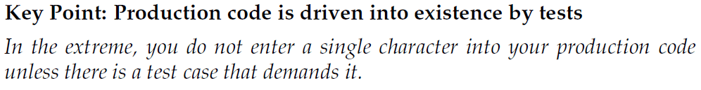
Test-Driven
It is called test-driven because it is driven by tests...
We only have one test case, 5c = 2 min, and the simplest possible implementation is ’return 2;’. No other test case force us to anything more!
Henrik Bærbak Christensen
Henrik Bærbak Christensen

Slide 45
Fake it ???
Fake it because:
  focus! You keep focus on the task at hand! Otherwise you often are lead into implementing all sorts of other code...
  small steps! You move faster by making many small steps rapidly than leaping,falling, and crawling back up all the time...
Henrik Bærbak Christensen
Henrik Bærbak Christensen

Slide 46
Warstory
I just have to change A a bit. However I soon find out that I need a new class B. Introducing B I can remove a lot of code from C; however this requires D to be massaged a bit. While doing this I discover a real bad bug in E that I have to fix first...
After two days – nothing at all is working – and I have no clue at all why I began all these changes...
Henrik Bærbak Christensen
Henrik Bærbak Christensen

Slide 47
Focus control
Fake It allows me to focus on the immediate problem:
I change A a bit. Done!
Henrik Bærbak Christensen
Henrik Bærbak Christensen

Slide 48
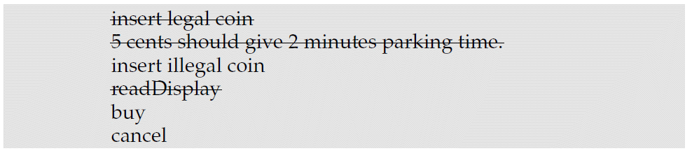
Step 4.
4. Run all tests and see them all succeed.
Nice feeling of success ☺
Remember to note the success on the test list
But – of course I am concerned! The implementation is wrong!
Henrik Bærbak Christensen
Henrik Bærbak Christensen

Slide 49
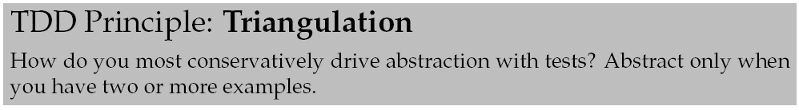
Step 4.
The point is that one test case is not enough to ensure a reliable implementation of the rate calculation! I need more test cases to drive the implementation.
Henrik Bærbak Christensen
Henrik Bærbak Christensen

Slide 50
Triangulation
The key point here is that return 2 is actually the correct implementation of the readDisplay if the only occuring use case is a person buying for 5 cents!
The conservative way to drive a more correct implementation is to add more examples/stories/scenarios => more test cases!
The above implementation is not correct for entering e.g. 25 cents!
Henrik Bærbak Christensen

Slide 51
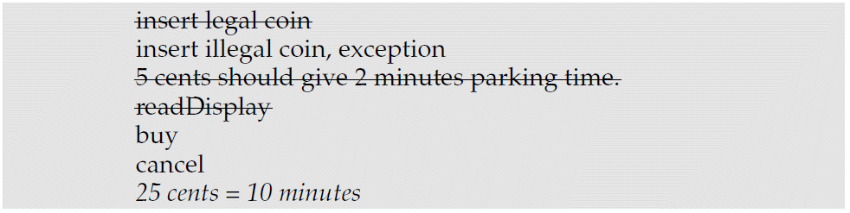
Triangulating
So I simply remind myself that Fake It is playing around in the production code by adding it to the test list:
Henrik Bærbak Christensen
Henrik Bærbak Christensen

Slide 52
Step 5
Refactor to remove duplication
I will come back to this....
Henrik Bærbak Christensen
Henrik Bærbak Christensen

Slide 53
Iteration 2: Rate Calculation
25 cent = 10 minutes

Slide 54
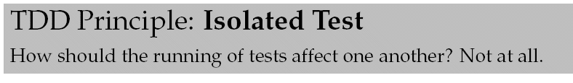
Step 1
1: Quickly add a test.
  but where?
Exercise: Why?
Henrik Bærbak Christensen
Henrik Bærbak Christensen

Slide 55
Step 1
Isolated Test guards you against the ripple effect
  Test 1 fails,
    leaving objects in another state than if it had passed
  Test 2 assumes the object state left by Test 1
    but is it different from that assumed – and Test 2 fails
  ... and all tests fail due to one single problem.
Morale: Isolate in order to overview failure consequences.
Henrik Bærbak Christensen
Henrik Bærbak Christensen

Slide 56
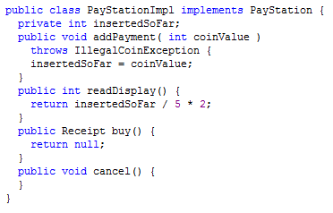
[Live programming]
Step 2: Fail…
Step 3: Make a little change…
Hi – this is wrong isn’t it???
  What should I do ??
Henrik Bærbak Christensen
Henrik Bærbak Christensen

Slide 57
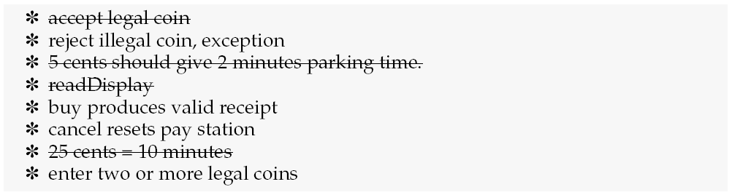
Tests drive implementation
Henrik Bærbak Christensen

Slide 58
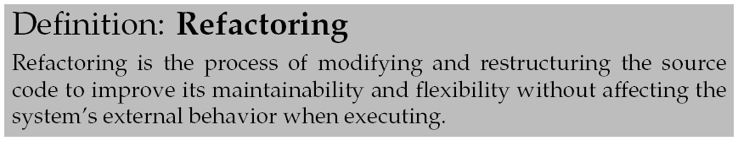
Step 5.
Testing code is also best maintained. I have duplicated the code that sets up the pay station object. I can move this to a Fixture which you define using the @Before annotation (JUnit) og @BeforeMethod annotation (TestNG).
Henrik Bærbak Christensen
Henrik Bærbak Christensen

Slide 59
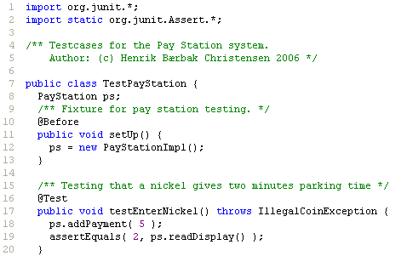
@Before
The @Before method always run before each test method. This way each test case starts in a known and stable object configuration.
Henrik Bærbak Christensen
Henrik Bærbak Christensen

Slide 60
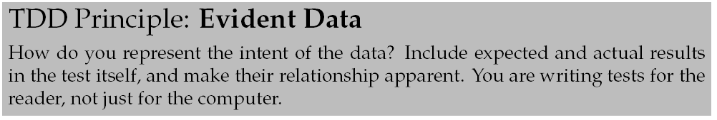
Magic constants
Henrik Bærbak Christensen
Henrik Bærbak Christensen

Slide 61
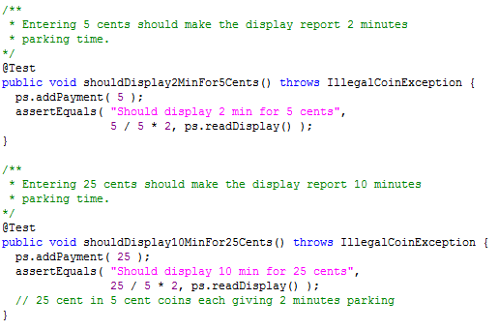
Evident Data
Henrik Bærbak Christensen
Henrik Bærbak Christensen

Slide 62
Iteration 3: Illegal Coin
The standard 17 cent coin ☺

Slide 63

JUnit Syntax
JUnit allows you to state the exception a given test method must throw to pass:
Henrik Bærbak Christensen
Henrik Bærbak Christensen

Slide 64
Iteration 4: Two Valid Coins
One Step Test: let us close the holes…

Slide 65
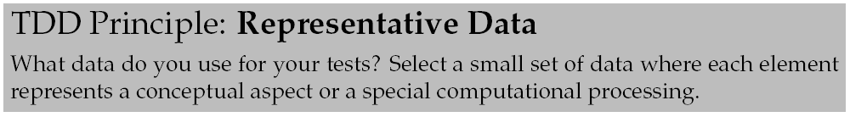
Step 1
What coins to use???
  I have already used a 5 and 25 cent, but have not tried 10 cent yet.
So – I decide to use a dime also!
  (but choosing the proper input values is a big topic on its own right!)
Henrik Bærbak Christensen
Henrik Bærbak Christensen

Slide 66

Rhythm
Step 1:
Step 2: RED
Step 3:
  insertedSoFar += coinValue;
Step 4: Huhh??? Fail???
  What happened?
Henrik Bærbak Christensen

Slide 67
Iteration 5: Buy
The Buy Scenario

Slide 68
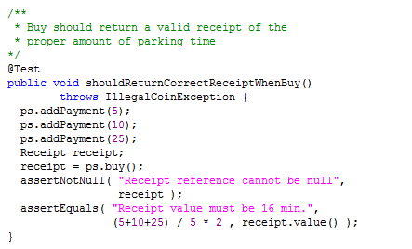
Step 1+2
Now – step 3 – make a little change...
Henrik Bærbak Christensen
Henrik Bærbak Christensen

Slide 69
3. Make a little change
Ups? Little change??? We need two changes
  An implementation of Receipt
  Implementing the buy method
Small steps? What are my options?
  The old way: Do both in one go!
    (I trust I could do that after 20 years of coding experience. However, the first time I did it last year, I actually got it mixed up. It was quite late though... ☺)
  Fix receipt first, buy next...
  Fix buy first, implement receipt later...
Henrik Bærbak Christensen
Henrik Bærbak Christensen

Slide 70
What would you do?
A) Do both in one go!
B) Fix receipt first, buy next...
C) Fix buy first, implement receipt later...
Let us vote ☺
Henrik Bærbak Christensen
Henrik Bærbak Christensen

Slide 71
Analysis
Take small steps tells us either B or C option:
  Fix receipt first, buy next...
    This is the natural order, because buy depends upon receipt, and not the other way around
    but I break the buy iteration!!!
      I have lost focus!
      Implementing Receipt means fixing a bug in B, that require a new class C, that would be better of if D had another method, that...
  Complete buy first – do receipt next
    But how on earth can I do that given the dependency structure?
What is your answer?
Henrik Bærbak Christensen
Henrik Bærbak Christensen

Slide 72
... and the winner is ...
[Drum roll...]
Henrik Bærbak Christensen
Henrik Bærbak Christensen

Slide 73
Fake it
Return a constant object
Henrik Bærbak Christensen
Henrik Bærbak Christensen

Slide 74
Fake it
Of course!
This is the whole point of Fake It!
(I has taken me a while to see that – but Fake It keeps me focused.)
I can complete buy by making a fake receipt. I keep focus! I am not lead astray.
Henrik Bærbak Christensen
Henrik Bærbak Christensen

Slide 75
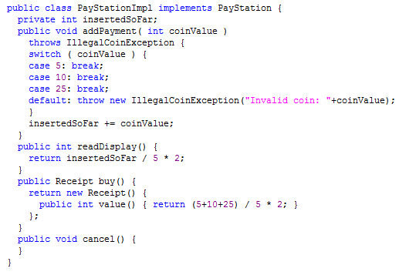
Fake Receipt
Java supports anonymous inner classes that do the job beautifully.
Henrik Bærbak Christensen
Henrik Bærbak Christensen

Slide 76
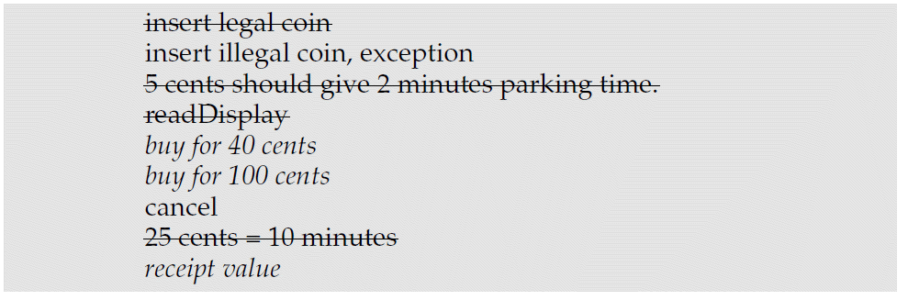
Step 4
Pass. Remember to ensure Triangulation down the road – update the test list:
Henrik Bærbak Christensen
Henrik Bærbak Christensen

Slide 77
Iteration 5: Receipt

Slide 78
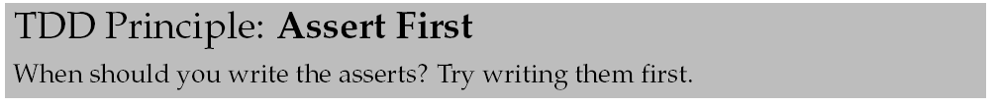
Step 1
Step 1 actually involves design in the small. How do I construct receipts?
Henrik Bærbak Christensen
Henrik Bærbak Christensen

Slide 79
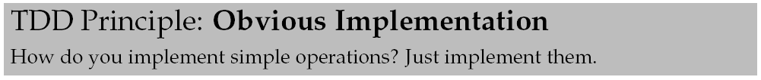
Step 3
The [Fake It, Triangulation] cousins are great for ‘driving’ algorithm development. However the really trivial algorithms we simply code
  Simple =
    set/get methods
    add a parameter in constructor that is assigned an instance variable
    that is code of 3-5 lines simple complexity ☺
Henrik Bærbak Christensen
Henrik Bærbak Christensen

Slide 80
Iteration 6: Buy (Real)

Slide 81
Step 1
Buy for 100 cent.
Exercise:
But how to enter 100 cent?
  add 5, add 5, add 5, add 10, add ...
  for ( int i = 0; i <= 20; i++ ) { add 5; }
  private method add2Quarters()
Henrik Bærbak Christensen
Henrik Bærbak Christensen

Slide 82
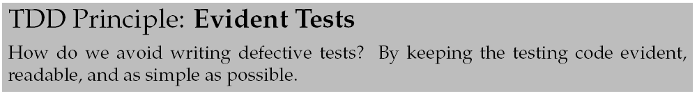
Evident Tests
Avoid loops, conditionals, recursion, complexity in your testing code.
Testing code is as dumb as possible.
Because testing code is code and you make mistakes in code!
  assignment, creation, private method calls
  and not much else!
Henrik Bærbak Christensen
Henrik Bærbak Christensen

Slide 83
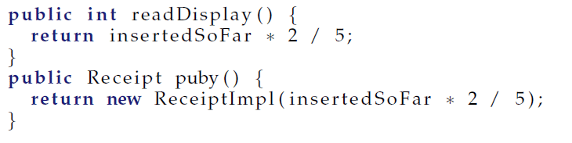
Step 5
Refactoring
I introduce a new instance variable:
  int timeBought
  to hold the time bought so far
But how do I ensure that I do this reliably?
buy
Henrik Bærbak Christensen
Henrik Bærbak Christensen

Slide 84
The Power of Tests
Well – I can do so without fear due to all the test cases I have made so far...
This is important!
  Tests are not something the QA team and customers own
  They help me as programmer to dare touch my code!
Henrik Bærbak Christensen
Henrik Bærbak Christensen

Slide 85
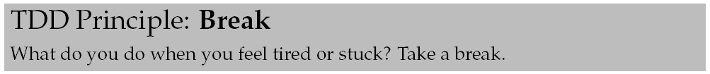
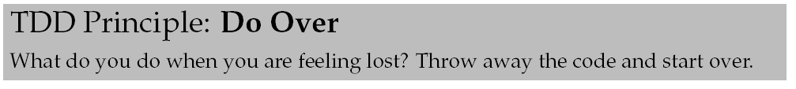
... and so on
Remember the important principles
Henrik Bærbak Christensen
Henrik Bærbak Christensen

Slide 86
Conclusion

Slide 87
Clean code that works
The Test-Driven Development process in one short statement is
Clean code that works
But not in that order.
  First – you make it work
    quickly; making small steps; sometimes faking it
  Next – you make it clean
    refactoring, remove duplication
Henrik Bærbak Christensen
Henrik Bærbak Christensen

Slide 88
Confidence and reliability
TDD promises confidence for us as developers
  Green bar gives confidence
  Failing test cases tell exactly where to look
  We dare refactor and experiment because tests tell us if our ideas are OK.
  We have taken small steps, so getting back is easy (put it under version control !!!)
Reliability
  Code that is tested by good test cases is much better than code that is not ☺
Henrik Bærbak Christensen
Henrik Bærbak Christensen

Slide 89
To stay in control
Test code is an asset that must be maintained!
  All unit tests run all the time!
    If you change production code API you update the test cases as well!!! You do not throw them away!!!
  Green bar Friday afternoon means go home, play ball with the kids and have a beer!
Bug report from customer site?
  A) Make a test case that demonstrate the failure
  B) Correct the defect
Henrik Bærbak Christensen
Henrik Bærbak Christensen

Slide 90
Programming process
Principles define language!
  I can say what I do when I code !!!
    Can you explain to your mate why you code it like this and not like that? And – is this better than that???
  It is reflected practice instead of divine inspiration and black magic...
Henrik Bærbak Christensen
Henrik Bærbak Christensen

Slide 91
Reversing order of implementation
Many program ‘bottom-up’
  My client needs class X so I
    write class X
    write the client code that uses X
This often gives inferior software because the order is “wrong” – you only find out what X should really have done and how the API should really have been after you have made X. Thus X is either rewritten or we just live with stupid method names, unused parameters, and odd calling sequences...
TDD focus on the client’s usage of X before writing X. This clarifies the requirements better!
Henrik Bærbak Christensen
Henrik Bærbak Christensen

Slide 92
Tool support
xUnit will help us to
  Write test cases and test suites
    Using annotations like [Test] and [SetUp] / @Test and @Before
  Organize and group test cases
    In hierarchical test suites
      does not work with JUnit 4.x any more ☹
  Execute test suites
    Hit the ‘run’ button
  Diagnose bugs
    Examine the failed test case and correct
Henrik Bærbak Christensen
Henrik Bærbak Christensen

Slide 93
Literature
Henrik Bærbak Christensen:
  Flexible, Reliable Software, CRC Press 2010
Kent Beck:
  Test-Driven Development by Example, Addison-Wesley 2003.
    A whole book on money conversion ☺
Martin Fowler
  Refactoring – Improving the Design of Existing Code, Addison-Wesley 1999
Henrik Bærbak Christensen
Henrik Bærbak Christensen

Slide 94
Outlook

Slide 95

Behaviour-Driven Development
Idea: Get rid of the testing terminology and think requirements and accept tests instead!!!
Classes should do something (feature). Express it directly in the test case names!!!
Henrik Bærbak Christensen
Henrik Bærbak Christensen

Slide 96
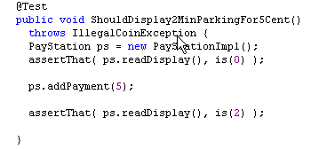
New JUnit 4.4 Features
Much more complex (and perhaps more readable?) assertions:
Henrik Bærbak Christensen
Henrik Bærbak Christensen

Slide 97
Principle Summary
Henrik Bærbak Christensen

Slide 98
Principle Summary
Henrik Bærbak Christensen

